Slide 1



Slide 2

Project presentation on “Quiz game”
-Developed and presented by team dual dolphins
Presented to:
MR. OHIDUZZAMAN SHUVO
Lecturer in CSE
Green university of Bangladesh
Presented by:
Md. Adnan Abir(202902035)
And
Nura Anha Tamanna(202902002)
Green University OF Bangladesh

Slide 3


Slide 4

Content:
Introduction
Social Importance
Motivation
Description
Features
Functions
Requirements
Outcome
Conclusion

Slide 5

Introduction:
A number of question are asked to check the General knowledge of the participates.

Slide 6





Social Importance:
Enhance meaningful knowledge
inspire the students
promote active learning
self-teaching and learning
provide motivational impetus

Slide 7




Motivation:
Learn new things
motives to create question
Boost your mind
Learning is Fun

Slide 8

Description
Start
WARM UP ROUND
Correctly answer at least 2 question
CHALLANGE ROUND
Each right answer will be awarded $100,000
Win upto ONE MILLION

Slide 9





Features:
Attractive Starting menu
Red background and 3 beep for correct answer
Green background and 1 beep for correct answer
Secure admin Panel for specific task.
SOUND

Slide 10

Functions:
I have divided this project into many functions, and listed below are some of those which may help you understand the project better.
admin_login()
edit_score()
help()
reset_score()
show_record()
show_score()

Slide 11
Requirements:
SOFTWARE:
HARDWARE:
WINDOWS (ALL VERSIONS)
WORK EFFICIENTLY ON CODE BLOCK
INBUILT GRAPHICS DRIVER
RAM : 512 MB OF RAM OR HIGHER
PROCESSOR : 800 MHZ INTEL PENTIUM OR HIGHER
HDD : 40 GB OR MORE

Slide 12
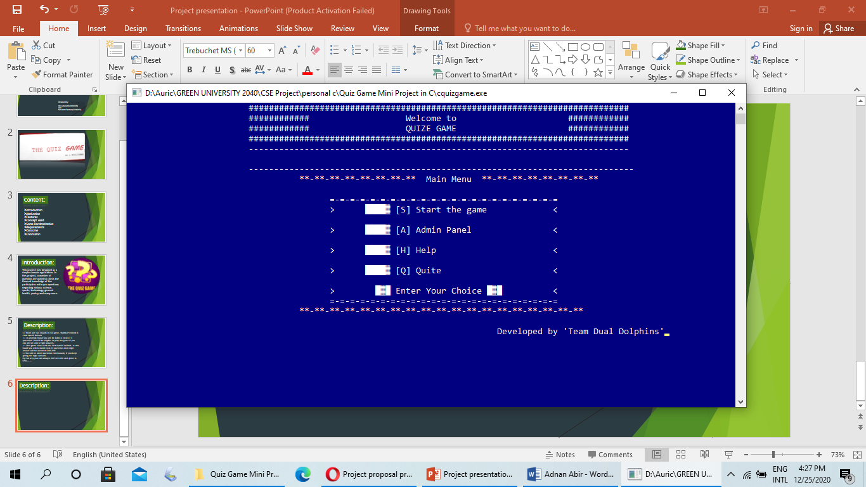
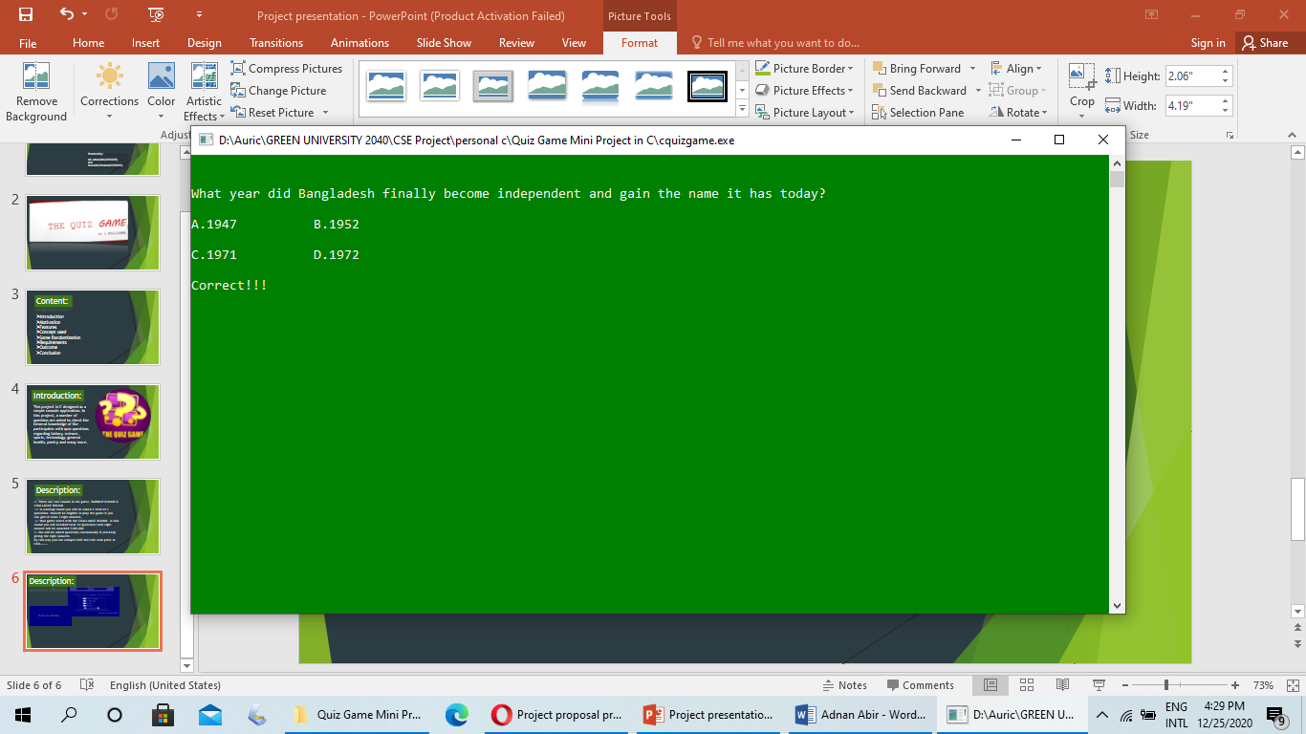
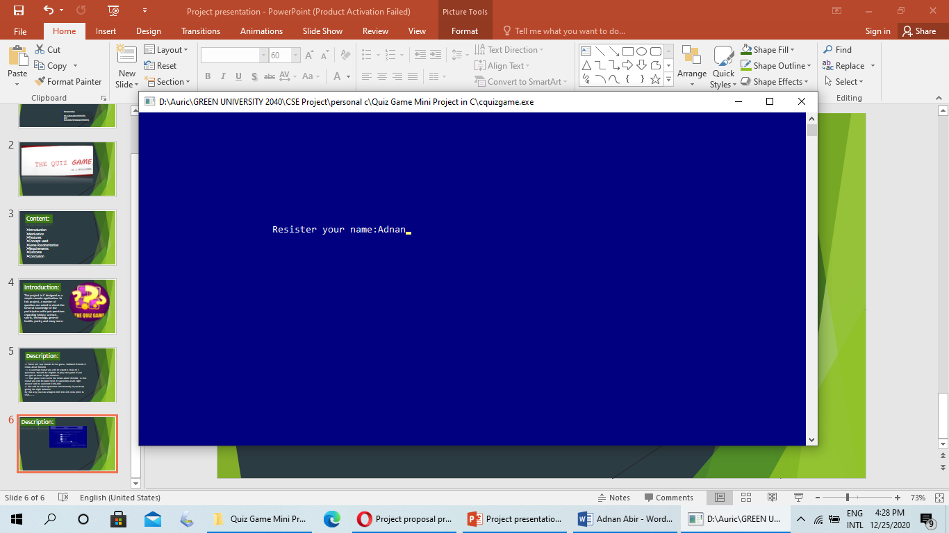
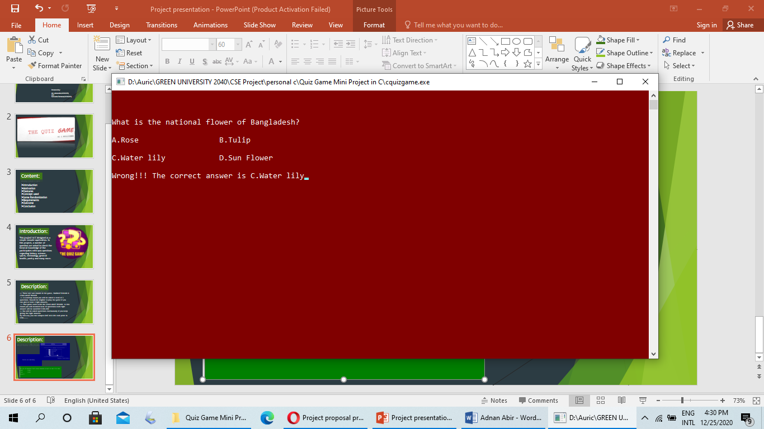
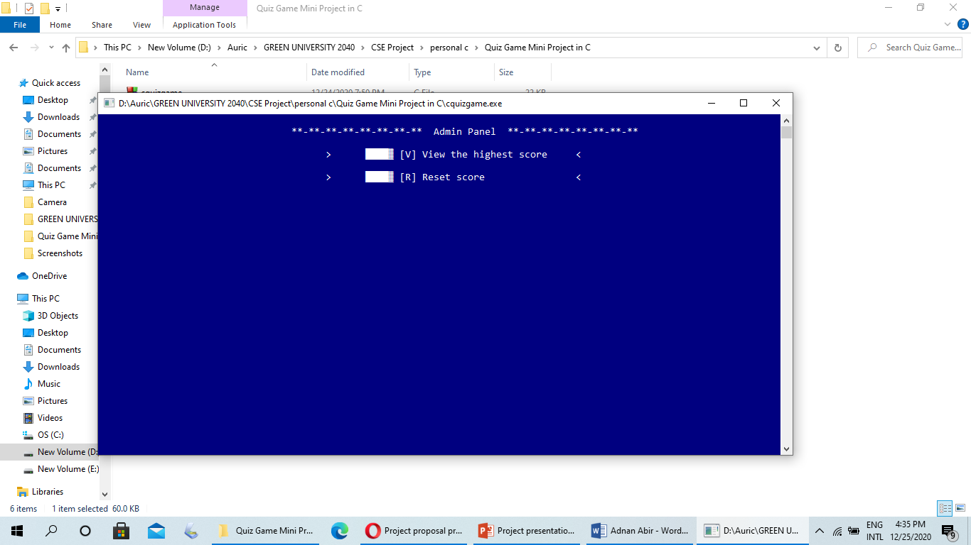
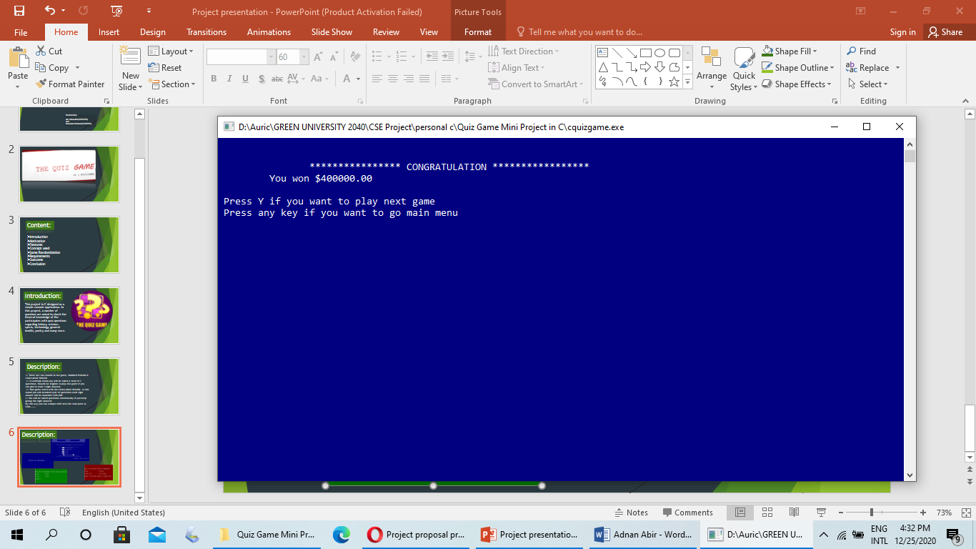
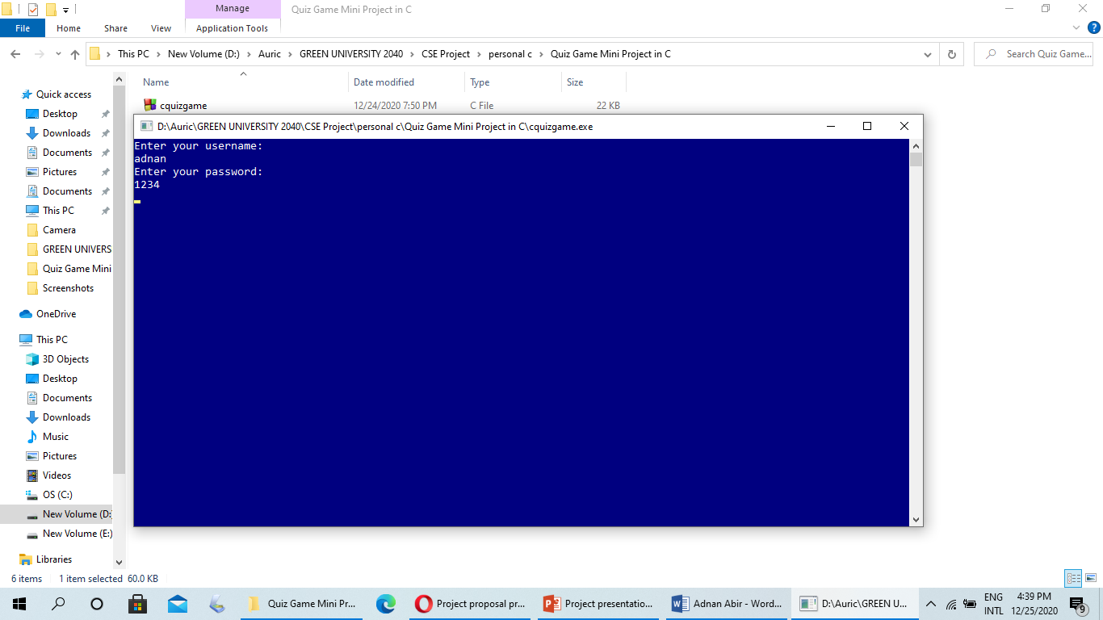
Outcome:

Slide 13

Conclusion:
Don’t be hesited to inform us, if you found any kind of bugs.
We will try our best to repair that as soon as possible.

Slide 14


